Slide 1
Developing A Pricing Model for Big Mountain Resort
Ninad Dixit

Slide 2
Problem Identification
Big Mountain Resort recently installed a new chair lift – operating costs increase of $1,540,000 in coming season
Current pricing strategy – charge a small premium over the average ticket price in US; may not be the best strategy
This project aims to develop a pricing model that will
Compensate the additional operating costs
Capitalize on the resort facilities to improve profits
Criteria for success
Find acceptable ticket price range based on the state of current facilities
Increase ticket price or reduce the costs to offset $1,540,000 of operating cost
Scope of solution
Price prediction valid only for the coming season
Facilities at all resorts in US are assumed to be of same quality

Slide 3
Recommendations and Key Findings
We explored the relationship between ticket price and resort facilities using a Random Forest model. The most influential facilities affecting the ticket price are:
Number of runs
Vertical drop
Snow making area
Recommendation 1 – Increase ticket price:
Model suggests ticket price in range $87.49 – $107.17 may be acceptable
Smaller price increase should also be considered
Recommendation 2 – Close least used runs:
Closing 6 least used runs may cover for $1,540,000 operating costs
Closing 10 least used runs may lead to > $2.3 M savings if current price is maintained
More information is required to make better predictions
Visitors history

Slide 4
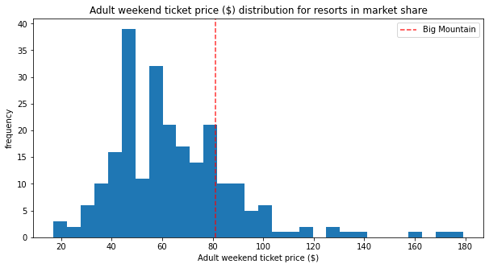
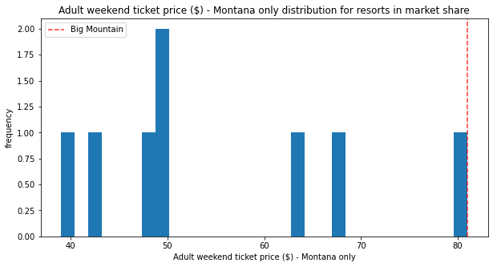
Modeling Results & Analysis
Current ticket pricing model:
Average ticket price across the US plus additional premium; does not take into account the available facilities.
Current price highest among that of Montana Resorts; need to estimate customers’ response before finalizing price increase.

Slide 5
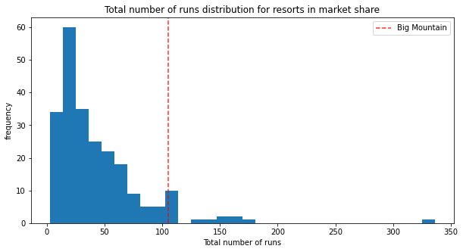
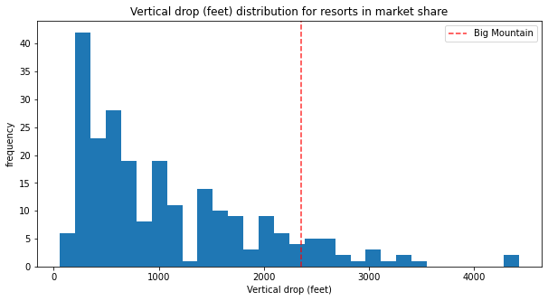
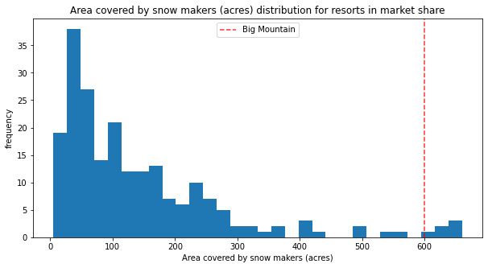
Modeling Results & Analysis
Big Mountain resort offers above-average facilities in the US market place
Hence, there is scope for some price increase

Slide 6
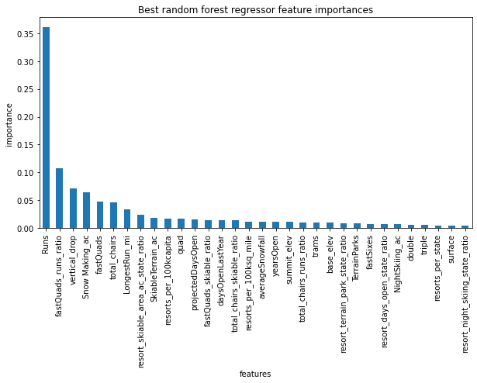
Modeling Results & Analysis
Linear Regression and Random Forest Regression were employed to estimate ticket price.
Random Forest approach performed better and was chosen for the project.
Most important facilities affecting the ticket price:
Number of runs
Vertical drop
Snow making
Fast quads
Number of chairs
Importance of ‘runs’ several times that of other facilities

Slide 7
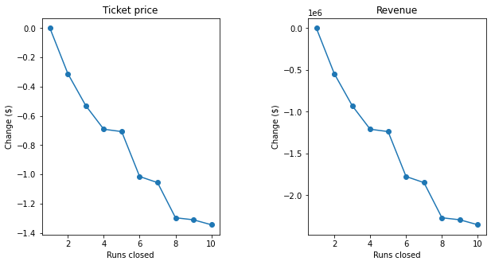
Modeling Results & Analysis
At current ticket price:
Closing 6 runs may lead to > $1.5 M of savings
Closing 10 runs may lead to > $2 M of savings

Slide 8
Summary and Conclusion
A pricing model was developed that allows Big Mountain resort to
Compensate the additional operating costs of the newly installed chair lift
Capitalize on the resort facilities to improve profits
Recommendations
Increase the ticket price in $87.49 – $107.17 range
Close least used runs to reduce operating costs
Further work – more information required better price prediction
Visitors’ history – number of visitors (weekdays vs weekends), age, new vs repeat visitors
Previous price increases and their impact on number of visitors / revenue
Alternative approach
Increase weekend ticket price and receive customer feedback

